Slide 1
Orientation to “DEVELOPERS” in Integrated Engineering Process Presented by: PALM [Earlier: Process Team]

Slide 2

Agenda
Introduction to PALM
Introduction to Quality Management System
Quick Glance at Q@Core
Project Lifecycles
Overview of ALM-DevOps Practices & Integration
Accountability as a developer
Development Environment setup
Tool Setup
Development Activities
Complement to Project Management
Contribute Horizontally!
Q&A
Notes:
Still WIP.. Will keep updating

Slide 3

Introduction to PALM
Productivity Assurance & Lifecycle Management (PALM), formerly known as Process Team
Aims to build the culture of Process Oriented & data driven implementation
Defines the right set of practices in the organization, with help of Practitioners
Emphasis on Tools driven practices rather than manual or documented way
Brings the flexibility required in context of project(s); enables adopting & integrating Customer specific processes
Interaction between PALM & Delivery team starts right at the project start.
Notes:
Still WIP.. Will keep updating

Slide 4
PALM – Functioning
New Customer Care [NCC]
Process Definition & Auditing Team
Process setup for New Customer projects
Conduct session on Best Practices and required tools
ALM tool setup and customization & consulting
Facilitates, Reviews and Suggests
Report results to Sr. Management
Stabilize Process & Tool usage in first 3-4 months
Transitions the Project to Auditing Team.
Process Definition & Maintenance
Impart Process & Tool Trainings
Provides Process and ALM tool consulting
Facilitate Implementation of ALM / Tool driven Practices
Conduct Audits on defined periodicity
Report Project health to Sr. Management & Executive Management
Involved in Process automation
Facilitate other Continuous Improvement Initiatives.

Slide 5

Quality Management System at Cybage
Notes:
Still WIP.. Will keep updating

Slide 6
Quick Glance at Q@Core
Apex Manual
Organization information
Organization & Project Structure
Lifecycles and Execution Models
Overview of Processes
Roles and responsibilities
Information of enabling functions
Process Manual
Traditional Development
Engineering
Project Management
Agile Development
Scrum
Kanban
Horizontal Processes
Support Services
Content Services
Business Processes
Departmental Manual
Human Resource
Administration
Information System
Notes:
Still WIP.. Will keep updating

Slide 7
Process Manual
Traditional Development Practices
Agile Development Practices
Engineering
Project Management
Agile Methodology
Scrum @ Cybage
Kanban @ Cybage
Project Initiation Process
Process for Scrum Projects
Process for Kanban Projects
Development Lifecycle
Project Initiation
Testing Lifecycle
Project Planning & Monitoring
Maintenance Lifecycle
Change Management
Project Closure

Slide 8








Process Manual
Horizontal Processes
Internal Audits
Configuration Management
Engineering
QMS Management
Knowledge Management
Root Cause Analysis
Continuous Improvement
Project Management
Resource Management
Decision Analysis & Resolution
Notes:
Let us now know each of the processes in detail… Let us start with SDLC..
Requirement Management and Development:
Ensures that both technical and non-technical requirements are captured, understood, documented and agreed upon with the customer.
In this process, template to document requirement understanding and ask queries to customer is defined i.e. Requirement Understanding Document, that’s RUD. A template to properly define requirements is also available, called as SRS.
One need not google to find how SRS should be prepared, what all should be the content in it. Just download it from Q@Core.
This process also includes sign-off of requirements with customer and baseline the requirements.
Now in agile world, things are managed as a part of Release Planning, Sprint Planning.
There are various tools to manage requirements, like Microsoft TFS, Atlassian Confluence, Rally etc.
Design:
This process ensures that software requirements are converted to technical design that forms the framework for coding and verifies proposed solutions based on requirements.
There are a few templates made available to ensure the proper design coverage like Architecture Design, Sub system level design, UI Design. If the person doing design is not using the provided templates, then she or he may miss the important pieces that should have been thought of while designing.
Construction Process:
This comprises of processes for coding and unit testing. What it says is – Understand the design, write unit test cases, set-up development environment, do coding, perform unit testing, get the code reviewed, debug the code and pass it on for compiling and build process.
From recent past, there have been tools used in the projects for Unit Testing and Code Review. SonarQube is mandated in Cybage for ensuring code quality.
Build and release Process:
This process is about building the unit tested code and doing sanity testing and sending it to QA.
There are 3 types of builds defined at Cybage –
Internal build – That is for QA team only
Client Release - That is to be released to client
Patch – Patch fixes for internal QA and/or for customer
This process expects Release Notes and Read Me should be available with build.
In the current world, Tools are used for build process like TFS, Jenkins, Bamboo, etc.
Testing Process:
Ensures comprehensive testing to check the product conformance with the requirements, before it is released to the customer using test plan, test cases and test reporting.
Deployment:
This is about deploying the product or application at production environment smoothly.
Any question here?
Am I okay with speed? Should I slow down or increase the pace ?

Slide 9

Lifecycle & Execution Methodologies

Slide 10
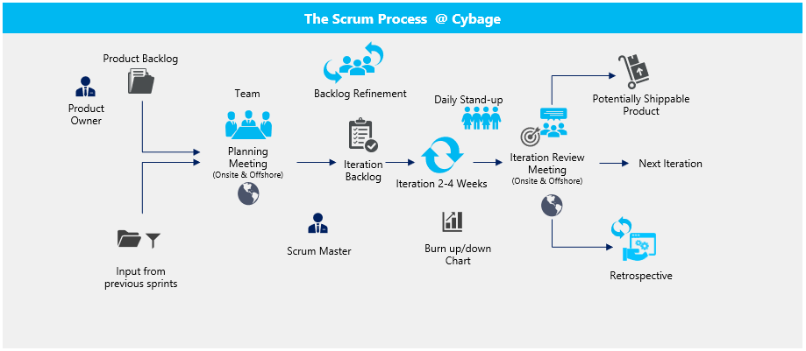
Scrum

Slide 11
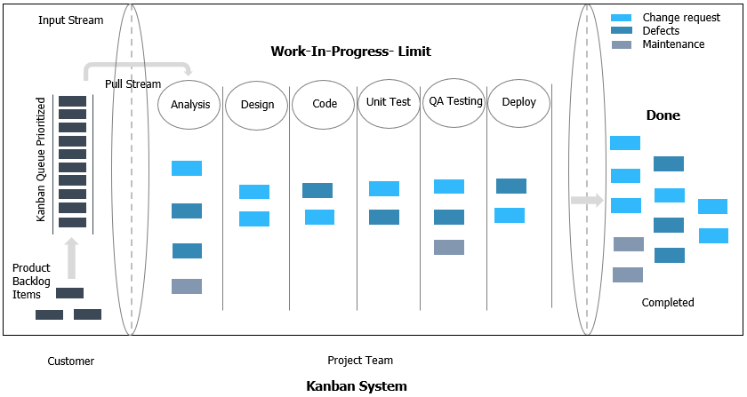
Kanban

Slide 12



Waterfall, Maintenance & Testing Lifecycle
Requirements
Build & Test
Unit Tests
Design
Maintenance Request
Impact Analysis
Implementation
Deploy
Development
Testing
Requirement Analysis
Test Planning
Test Case Design
Testing
Deployment
Test Closure
Regression Testing
Defect Retesting
Test Result Reporting
Maintenance

Slide 13
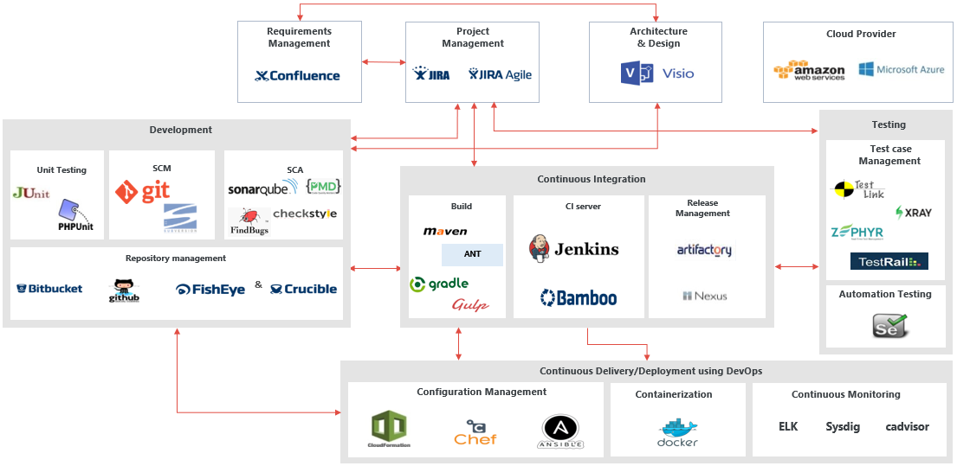
ALM-DevOps Practices & Tool Integration – Opensource & Licensed Tools

Slide 14
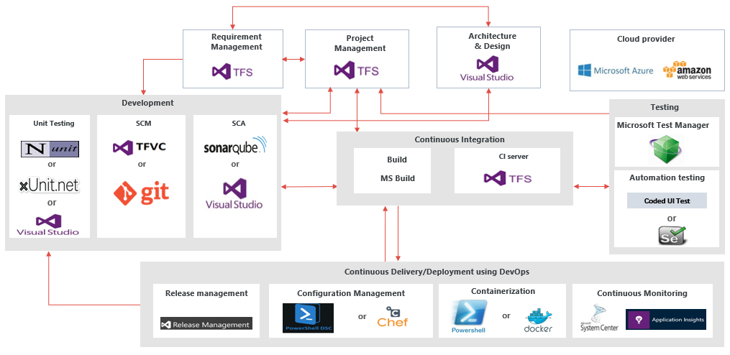
ALM-DevOps Practices & Tool Integration – Microsoft Tools

Slide 15
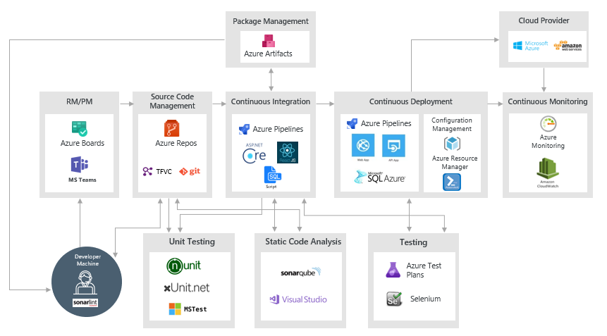
ALM-DevOps Practices & Tool Integration – Microsoft Azure

Slide 16

Role – DEVELOPERS

Slide 17

Accountability as a developer
The Developers are always accountable for:
Creating a plan for the Sprint, the Sprint Backlog
Instilling quality by adhering to a Definition of Done;
Adapting their plan each day toward the Sprint Goal; and,
Holding each other accountable as professionals.

Slide 18

Project Kickoff
Participate in project kickoff
Get information of environment & tools identified for the project
Know about in-scope, out-scope activities & requirements
Know the Methodology, Deliverables & Timelines
Understand assumptions, dependencies, constraints & risks in the project
Get familiar with - Team hierarchy, Reporting requirements, Escalation Protocols
Receive Training / KT / Ramp up of project from Client and Other relevant stakeholders like BA, Architect, Other vendors (if involved).

Slide 19
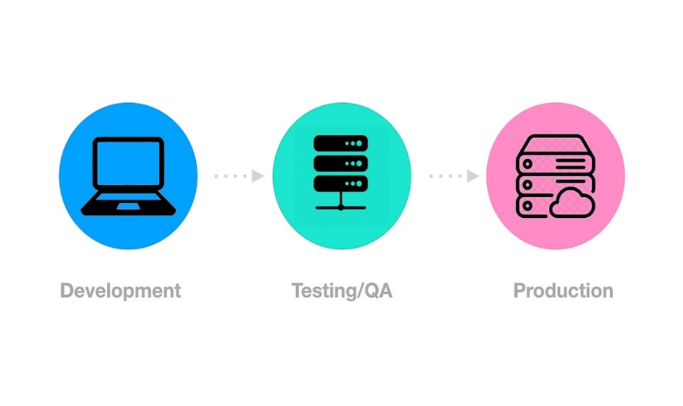
Development Environment setup
Development environment is a set of processes and tools for developing an application or program.
Set-up requirements:
Knowledge of customer & business requirements
Operating system, Hardware & Devices
IDE Configuration like visual studio, eclipse etc.
Setting up the extension(s) and plugin(s) like SonarLint, NUnit, NCrunch etc.
Licensing, third party software or software for user purpose.
Note: Make sure that development environment is replica of production environment, as much as possible; and refresh/ revisit the environment, as per the defined frequency.

Slide 20

Tool Setup
Know the tools to be used in project
Identify all work item types to be used
Understand the workflow for the work item types
Establish Integration of repository management and CI/CD tools
Know the development/branching strategy (Git flow or Trunk based)
Understand the branch protection rules configured
Understand merge checks applied
Integrate static code analysis tool in CI pipeline to execute it automatically once you merge your code
Identify labels/tag, e.g.: functional, non-functional, CR etc.

Slide 21

Development Practices
Copyright © 2021 Cybage Software Pvt. Ltd. All Rights Reserved. Cybage Confidential.
www.cybage.com

Slide 22
Backlog Refinement
Product Backlog: A product backlog is a list of everything that needs to be achieved on a project, broken down into individual items, called user stories
Product Backlog Refinement/Grooming: A recurring event for Agile teams to ensure that the product backlog is understood by team and the right user stories are prioritised for the upcoming sprints.
Revisit items on the product backlog to make sure that the backlog contains the right items, and they are prioritized
Understand Requirements / Features/ Stories
Help product owner in refining and prioritizing the backlog items
Break larger PBI's up into smaller PBI’s
Provide estimation based on type of estimation & techniques used in the project
Discuss & ask queries to product owner with respect to user stories & acceptance criteria
Re-estimate Product Backlog items with respect to the newly discovered information
Update the requirement management tool with the responses.
Participate in the risk analysis of user stories.
For more information on Sprint Refinement, refer Product Backlog Refinement Guideline.
Notes:
Important: it is supposed to stay like that because of the animation. Do not change.

Slide 23

Backlog Refinement – Best Practices
Ensure that the product backlog items are updated in line with any discussions held or clarifications made
Keep Definition of Ready handy & use it as a checklist for backlog refinement
Make it DEEP (Detailed appropriately, Estimated, Emergent and Prioritized)
Keep clear understanding of dependencies & constraints.

Slide 24
Sprint Planning
A time-boxed event that occurs at the beginning of a sprint/iteration where the team determines the product backlog items, they will work on during that sprint.
Have the individual capacity updated prior to the sprint planning meeting
Participate in sprint planning meeting
Negotiate with the product owner and finalize the Sprint Goal and plan for delivering the increment
Select items from the Product Backlog to include in the current Sprint and refine as required to increase understanding and confidence
Determine how much work you can do realistically to meet the Sprint goal
Breakdown sprint backlog items into tasks
Estimate the tasks and see if the efforts are inline with the story points
Highlight dependencies, risks and impediments (if any)
Self assign the tasks.
For more information on Sprint Planning, refer Sprint Planning Guideline.
Notes:
Important: it is supposed to stay like that because of the animation. Do not change.

Slide 25
Best Practices - Sprint Planning
Keep the sprint goal in mind
Keep meetings timeboxed
Ask questions to clear any ambiguity
Do not commit more than you can not deliver
Remember to think of your personal availability for the coming sprint.

Slide 26
Activities in Iteration/Sprint
Design
Design can be incremental or up-front.
Participate in architectural design creation, if involved
Get the created design artifact(s) reviewed internally and share it with the relevant stakeholders (E.g., Client, Architect) for their approval.
In case the design artifacts are provided by client, analyze them, and get the queries cleared from the POC.
Note: Up-front design comes even before planning the first sprint.

Slide 27
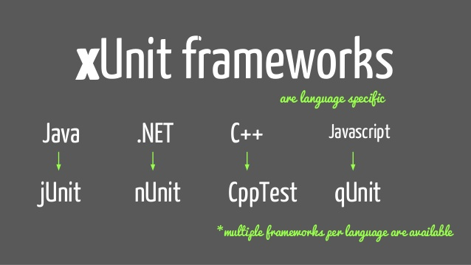
Activities in Iteration/Sprint
Unit Test Creation
Write automated unit test cases (test scripts)
Make use of Unit Testing frameworks like nUnit, Jasmine, jUnit, PHPUnit
In case of manual unit testing, write unit test cases and maintain the records
Ensure to update unit tests for changes in functionality.
Note: In case project does not have QA/Testing in scope, Unit test Scripts/Cases reviews are highly recommended.

Slide 28
Activities in Iteration/Sprint
Development/Coding
Study the design
Clone the remote repository to local (If working for the first time) or pull the repository
Create a branch, as per the branching strategy defined
If working on legacy code, baseline the code quality measures (Running Static Code analysis)
Configure the extension(s) and plugin(s) to IDE (like SonarLint, NUnit, NCrunch etc.).
Construct code as per the Story/Feature Description and defined Acceptance criteria
Follow proper coding standards defined for technology used in project
Perform Static Code Analysis using tools like SonarQube, FxCop, Veracode
Make sure all the quality gates configured, are passed
Fix the bugs identified in static code analysis
Execute the Unit Test Cases/Scripts.
Notes:
Please make sure to mention this: In case if Static Code Analyzer is not integrated with the CI server, invoke static code analysis manually

Slide 29
Activities in Iteration/Sprint
Development/Coding
Commit code with appropriate commit message E.g., User story ID, limit the message to 50 characters.
Tag the commits before pushing
Recommend creating annotated commit tags if required to maintain the information/ history E.g.: git tag -a v1.0 -m “My Version 1.0”
Create a pull request in repository management tool for the code committed to be reviewed
Perform code review (as per the required {#} reviewers) and provide the review comments
Incorporate the review comments provided by the reviewer in the tool
Verify if the review comments are incorporated and approve the pull request
Fork a repository while experimenting or helping with other people’s work
Perform Static Code Analysis to get the code coverage (as per identified threshold)
Merge the code with the designated branch
Fix the bugs reported by QA Team.

Slide 30
Best Practices - Development
Follow branch naming convention rules, use User Story ID.
Perform one round of internal code review before customer review
At least 2 reviewers should review and approve the code, before merging
Label the PRs for easy categorization
Avoid giving verbal review comments.

Slide 31

Activities in Iteration/Sprint
Build (Continuous Integration)
Create build definition.
Set up the CI pipeline.
Possible steps may include the following but, not limited to:
Artifact Management (E.g.: JFrog Artifactory, Nexus, etc.)
Source Code Management (E.g.: GitHub, Bitbucket, etc.)
Unit Test Scripts
Static Code Analysis
QA Test scripts (E.g.: Smoke, Integration, Regression, etc.)
Notification configuration (E.g.: Email, IM, etc.)
Build
If the job status is ‘SUCCESS’/ ‘PASS’/ any other label convention, a package is created.
A notification is sent to the repository manager to store the binaries produced, the package, build information, dependencies and unit test results (E.g.: Jenkins on Job status as ‘success’, creates a package and notifies JFrog using plug-in to store it along with its meta-data).
Note: Creating build definition may vary upon tool to tool.
Notes:
E.g.: In azure DevOps, Create pipeline, select Azure Repos git, select template, set the agent pool (Azure pipeline, default), add task to select visual studio and set the properties, add a task to publish build artifact and fill the necessary details, finally set the trigger status to enabled.

Slide 32
Activities in Iteration/Sprint
Build (Manual)
Send a notification to Build Engineer to inform about code freeze
Generate the Build ID/ version.
Get the latest checked in Source code and compile it.
Create the Build by taking code from the latest version.
Create Read Me and Release Notes
Communicate build details to relevant stakeholders (QA/Client).

Slide 33
General Activities - Iteration/Sprint
Participate in daily scrum meeting and discuss the progress towards meeting the sprint goal
Keep updating the status in tools
Log efforts on daily basis
Collaborate with team members (for help required, task dependencies)
Highlight real time queries to appropriate stakeholders and get them resolved
Highlight dependencies
Identify measures for yourself and monitor them. Ex: Issues, Quality, Lines of Code
Make dashboard for yourself for self tracking.

Slide 34
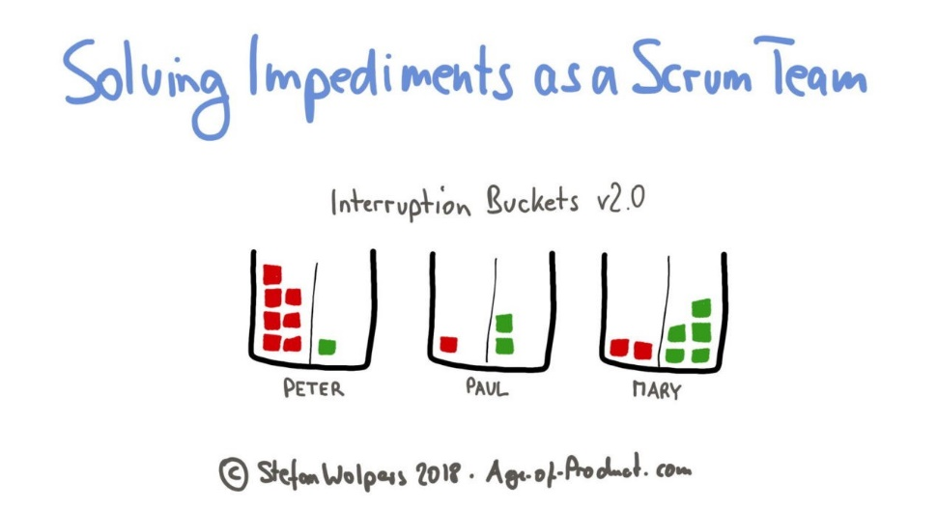
Tactics for Removing Impediments
Do not wait until the Daily Scrum to raise an impediment!
Use a sprint goal to decide if something is truly an impediment
Improve transparency by using an 'Impediment Board’
Keep track of fixed impediments
Be brave and creative in removing impediments
Help other teammates with their impediments.
Examples: Illness of team members, Lots of technical debt, Unavailability of the Product Owner
Notes:
Don't wait until the Daily Scrum to raise an impediment! Sure, one of the suggested Daily Scrum questions is "Do I see any impediment that prevents me or the Development Team from meeting the Sprint Goal?" But that doesn't mean the Development Team can only discuss impediments during the Daily Scrum.
Use a Sprint Goal. A clear Sprint Goal is an useful instrument to determine if something is truly an impediment. If something prevents the team from achieving the Sprint Goal, than it's definitely an impediment.
Understand the difference between 'blocks' and 'impediments'. A block affects only a single task, whereas an impediment acts like a parachute, slowing down overall progress. Quite often the Development Team can fix 'blocks' themselves whereas impediments need to be fixed by the Scrum Master [Scrum Shortcuts, I. Goldstein].
Improve transparency by using an 'Impediment Board'. This can be a simple flip-over where the impediments are visualized. Add some swimming lanes like 'to do, in progress, done' and the status is transparent for everyone. Of course you can also add the impediments to the existing Scrum board. Visualizing the status and increasing the transparency hereby is the most important.
Keep track of fixed impediments. This will provide great input for the Sprint Review and Sprint Retrospective.

Slide 35
Best Practices - Iteration/Sprint
Attach all the supporting artifacts with the User Story in tool
Perform code refactoring
Performing branch clean up activity
Conduct Knowledge sharing sessions frequently (weekly/ fortnightly basis)
Keep an eye on Information Radiators of the project E.g., Burn up / Down chart, Velocity Trend, etc.

Slide 36
Sprint Review/Demo
Sprint review is an activity at the end of the Sprint where the increment is presented to Product Owner, relevant stakeholders invited by PO to obtain their feedback on the developed product.
Participate in Sprint Review meeting.
'Inspect' the increment and 'Adapt' the product backlog
Demonstrate the work that has been “Done” and answer the questions about the Increment
Note down the action items if any review comments are there
Discuss what to do next (to subsequent Sprint).
For more information on Sprint Review, refer Sprint Review Guideline.
Notes:
Important: it is supposed to stay like that because of the animation. Do not change.

Slide 37
Best Practices - Sprint Review/Demo
Make sure to have event timeboxed
Treat all feedback as welcome feedback, especially from stakeholders
Ask for suggestions from everyone (including developers) on how to gain more value from the current and future features
Inspect sprint deliverable & adapt product backlog.

Slide 38

Sprint Retrospective
The Retrospective is a time-boxed event in agile providing an opportunity to the team to inspect itself and create a plan for improvements to be enacted during the next iteration.
Participate in retrospective meeting
Discuss What went well in the Sprint, What impediments were there
Revisit actions from previously conducted retrospective
Commit on what to improve in the next Sprint
Make sure every issue or idea is clear to all team members
Techniques to perform Retrospective
Start, Stop, Continue
Mad, Sad & Glad
4 Ls (Liked, Learned, Lacked, Longed for)
KALM (Keep, Add, Less, More) etc.
Tools: TeamRetro, Ideaboardz, Confluence, FunRetro etc.
For more information on Sprint Retrospective, refer Sprint Retrospective Guideline.
Notes:
Important: it is supposed to stay like that because of the animation. Do not change.

Slide 39
Best Practices - Sprint Retrospective
Provide honest feedback
Follow clear boundaries for the conversation
Define the time period and discussion points, and focus on improvements
Criticize Work, Not People
Own the meeting and take responsibility for the decisions you made.

Slide 40
Deployment
Continuous Deployment, is the Continuous Delivery pipeline without any manual gates/ manual intervention like: Manual testing, Code Reviews, Demo to Product Owner and/or stakeholders.
E.g.: A pipeline with stages ‘code check-in’ -> ‘automated compilation’ -> ‘build’ -> ‘unit tests’ -> ‘Automated test scripts’ -> ‘deployment to production’.
If deployment is successful
Replicate the stable build to other environment servers – as per the deployment strategy.
Notification is sent to required stakeholders on successful roll-out.
Monitor application performance metrics configured to keep a check on critical Infrastructure components.
Make use of tools for Infrastructure Monitoring (E.g.: Nagios, Splunk, etc.)

Slide 41
Deployment
If deployment is unsuccessful
Implement roll back steps as per the plan defined in deployment strategy for rollback
Document the scenario specific roll back procedures
Verify if the roll back is successful
Log the defect
Fix the issue
Roll out the repaired build to Production - environment
Verify if the build is stable.

Slide 42
Deployment
Manual deployment
Take the backup of the production/working environment
Install the build and execute deployment test cases.
In case of deployment issues:
Notify stakeholders.
Log the deployment defect in the defect tracking tool and apply label to it (Label of production issue)
Install the previous stable state & execute Roll-back test cases
Verify Roll-back, if successful
Notify stakeholders about the successful Roll-out
Conduct RCA of the issues.

Slide 43
Deployment
Post deployment issues
Verify the defects identified, post-deployment
Log the defect in the defect tracking tool, if required
Perform the fixes (can be a patch) or rebuild as per the build steps
Execute the deployment test cases, if required
Notify the relevant stakeholders about the fix
Conduct Postmortem / Root Cause Analysis of Post Deployment issues.

Slide 44



Complement to Project Management
Copyright © 2021 Cybage Software Pvt. Ltd. All Rights Reserved. Cybage Confidential.
www.cybage.com

Slide 45

Change Management
If any change request is received, discuss with lead
Participate in impact analysis and feasibility study, if involved
Log those in requirement management tools such as JIRA, Azure
Add appropriate labels to segregate these, helps in tracking!
Implement the change(impacted modules/files)
Update the status and communicate the change status to relevant stakeholders.
Note: Change Management process is specific to a waterfall projects. It is not applicable in Agile projects.
Notes:
Mention that this slide is waterfall specific.

Slide 46

Risk Management
Risk is any potential threat which can affect the project.
Identify the possibility of technical risks occurring
Identify the impact of risk
Share the risk with PM, SM/PO & Team members as required
Provide inputs to reduce risk impact.

Slide 47

Root Cause Analysis (RCA) & Decision Analysis
Participate in collecting and analysing the data for analysis.
Participate in RCA, Decision analysis
Perform the necessary actions identified.
Root Cause Analysis techniques
5 Why Analysis
Pareto Analysis
Fishbone Analysis
Decision Analysis techniques
Decision Matrix Analysis
Forced field Analysis
Brainstorming
Notes:
Note:
The 5 Whys method is part of the Toyota Production System. Developed by Sakichi Toyoda, a Japanese inventor and industrialist.
“The basis of Toyota’s scientific approach is to ask why five times whenever we find a problem … By repeating why five times, the nature of the problem as well as its solution becomes clear.“ Taiichi Ohno
The root cause analysis process should include people with practical experience.
Keep in mind that “5” is just a number. Ask “Why” as many times as you need to complete the process and take appropriate actions.
Fish Bone Analysis
Agree on a problem statement (effect). Write it at the centre right of the flipchart or whiteboard. Draw a box around it and draw a horizontal arrow running to it.
Brainstorm the major categories of causes of the problem. If this is difficult use generic headings: Methods, Machines (equipment), People (manpower), Materials, Measurement, Environment
Write the categories of causes as branches from the main arrow.
Brainstorm all the possible causes of the problem. Ask "Why does this happen?" As each idea is given, the facilitator writes it as a branch from the appropriate category. Causes can be written in several places if they relate to several categories.
Again ask "Why does this happen?" about each cause. Write sub-causes branching off the causes. Continue to ask "Why?" and generate deeper levels of causes. Layers of branches indicate causal relationships.
When the group runs out of ideas, focus attention to places on the chart where ideas are few.

Slide 48

Root Cause Analysis Techniques
Please click on the video

Slide 49

Other Areas to contribute - Project Management
Estimations
Client Call Summary and Action items
Timely and concise status reports (if required)
Leave Calendars
Suggest improvements.
Notes:
Mention that this slide is waterfall specific.

Slide 50
Contribute Horizontally!
Copyright © 2021 Cybage Software Pvt. Ltd. All Rights Reserved. Cybage Confidential.
www.cybage.com

Slide 51

Configuration Management
Systematically controlling changes to the Configurable Items (CIs), maintaining the integrity and the traceability of CIs throughout the lifecycle.
Follow proper folder structure while creating a folder
Refer naming convention guidelines while creating an artifact
Write proper revision/update message while updating an artifact
Ensure that the latest version of artifacts are available for the entire team
Verify the required access rights to folders and artifacts
Configuration Management Tools: Confluence, Wiki, SharePoint, Git, Bitbucket, CVS etc.

Slide 52
Configuration Management - For Developers
Appropriate Branching
File naming & Code commits with appropriate Commit messages
Label the Pull Requests for categorization, if required (E.g.: In GitHub, labeling a PR as ‘duplicate’ indicates a similar pull request)
Perform Build versioning as per the Build Versioning Guidelines
Set the retention policy for the Build to be created, as required (E.g.: In Azure DevOps, the build to be retained for 60 days before deleting it).
Configure the drop folder for the Build to be published once created.
In case of rollback to a previous commit, refer the history of commits, and revert the previous stable commit
Clean up the unnecessary/ old/ hanging branches once the code is merged.
For more details, Refer Configuration Management Guideline and Git Best Practices & Guideline.

Slide 53

Resource Management
Participate in Product training, knowledge transfer by the customer during onboarding/execution of project
Ask for Ramp-up, if joined as new member in project
Participate in Ramp-up of new team members
Participate in the handover and takeover activity (if there is resource replacement).

Slide 54

Knowledge Management
The purpose is to gain knowledge, share perspectives, ideas, experience, knowledge, and information and to improve efficiency by reducing the need to rediscover knowledge.
Self-learning: Perform self-learning, and document the learnings
Shadow Hierarchy identified within project Team: Record /Store the Knowledge Management
Trainings: Identify technical areas where you might need assistance or trainings
Knowledge Sessions: Conduct/attend knowledge.

Slide 55

Do’s:
Actively participate in all scrum ceremonies
Keep the sprint goal in mind
Conform to the Definition of Done
Work log regularly
Update the project management and requirement management tool daily
Attach all artifacts with the User Story in tool
Add appropriate comments in tool
Seek help and provide help as and when needed
Collaborate with the scrum team.

Slide 56

Don’ts:
Wait till the sprint end to update tool
Try to over commit or accommodate last unprioritized items within the sprint
Perform verbal reviews
Formulate story points into efforts
Try to fix all defects in the same sprint, Defects should be prioritized
Let the daily scrum become a technical discussion or a planning meeting.

Slide 57


Thank You!
6/23/2022
www.cybage.com
Copyright © 2021 Cybage Software Pvt. Ltd. All Rights Reserved. Cybage Confidential.

